Slide 1
Newborn CF screening
CF Better together
ILDIKÓ HORVÁTH National Korányi Institute for Pulmonology
Newborn CF screening Ildikó Horváth
1

Slide 2
Aims of the presentation
CF Better together
Reasoning
International practice
Hungarian pilot project
2
Newborn CF screening Ildikó Horváth
2

Slide 3
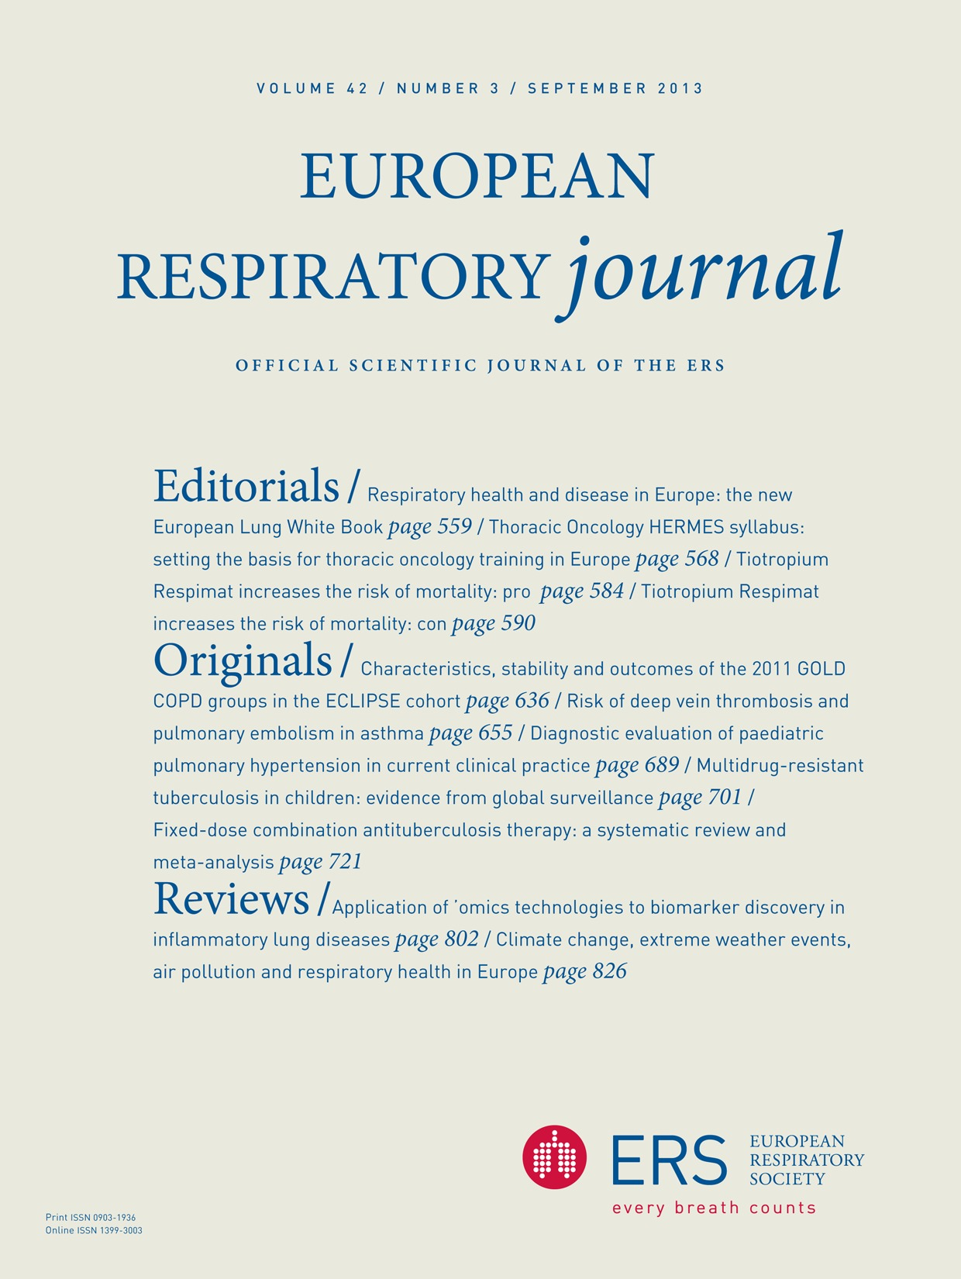
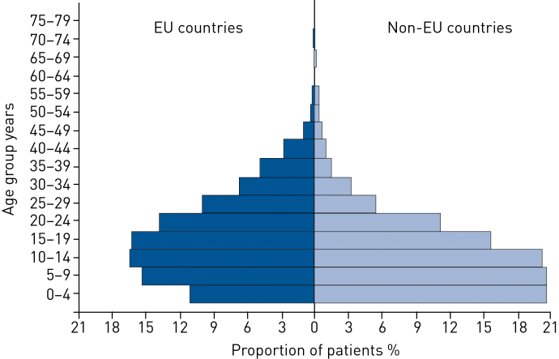
CF Better together
3
Newborn CF screening Ildikó Horváth
3

Slide 4
CF Better together
4
Newborn CF screening Ildikó Horváth
4

Slide 5
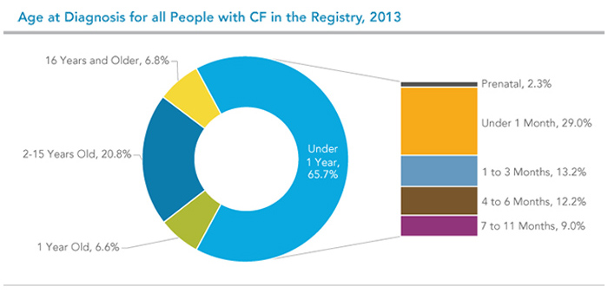
CF Better together
https://www.cff.org/uploadedImages/Content/What_is_CF/Testing/age-at-diagnosis.jpg
5
Newborn CF screening Ildikó Horváth
5

Slide 6
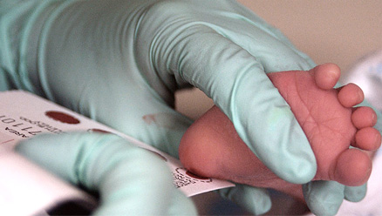
CF Better together
6
Newborn CF screening Ildikó Horváth
6

Slide 7
CF Better together
7
Newborn CF screening Ildikó Horváth
7

Slide 8
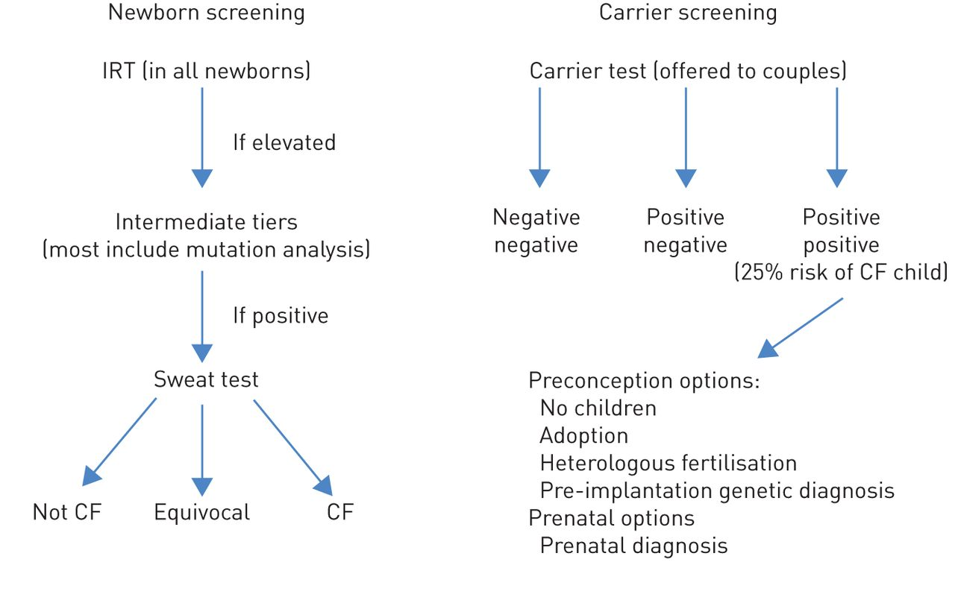
Flow of newborn and carrier screening for CF
CF Better together
Castellani C et al. Eur Respir J 2014. http://erj.ersjournals.com/content/43/1/20
8
Newborn CF screening Ildikó Horváth
8

Slide 9
CF Better together
https://image.slidesharecdn.com/nbs-cf-130819094342-phpapp01/95/twotier-newborn-screening-for-cystic-fibrosis-in-virginia-18-638.jpg?cb=1377444170
9
Newborn CF screening Ildikó Horváth
9

Slide 10
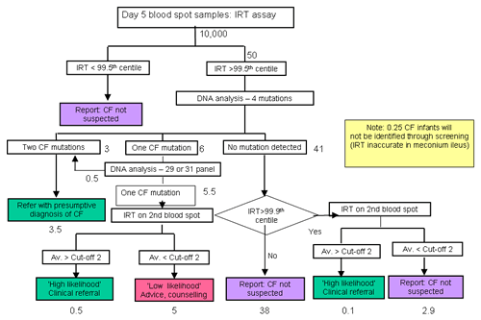
CF Better together
http://www.cfmedicine.com/htmldocs/images/natprotsmall.gif
10
Newborn CF screening Ildikó Horváth
10

Slide 11
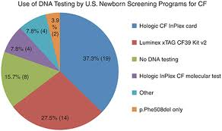
CF Better together
11
Newborn CF screening Ildikó Horváth
11

Slide 12
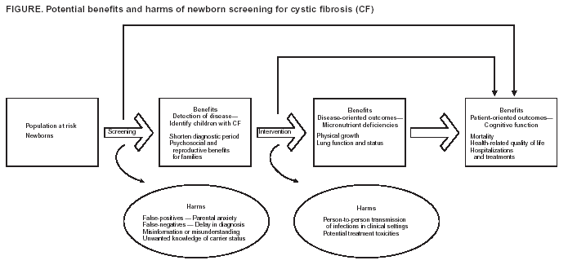
CF Better together
https://www.cdc.gov/mmwr/preview/mmwrhtml/figures/r313a1f.gif
12
Newborn CF screening Ildikó Horváth
12

Slide 13
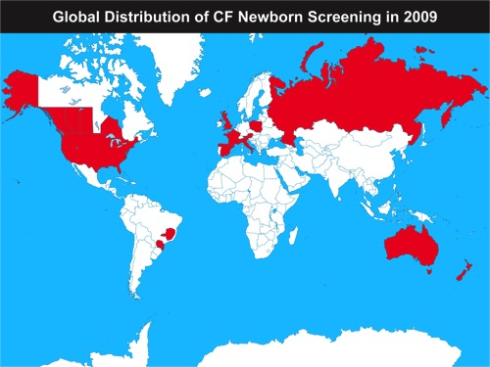
CF Better together
13
Newborn CF screening Ildikó Horváth
13

Slide 14
CF Better together
14
14
Newborn CF screening Ildikó Horváth
14

Slide 15
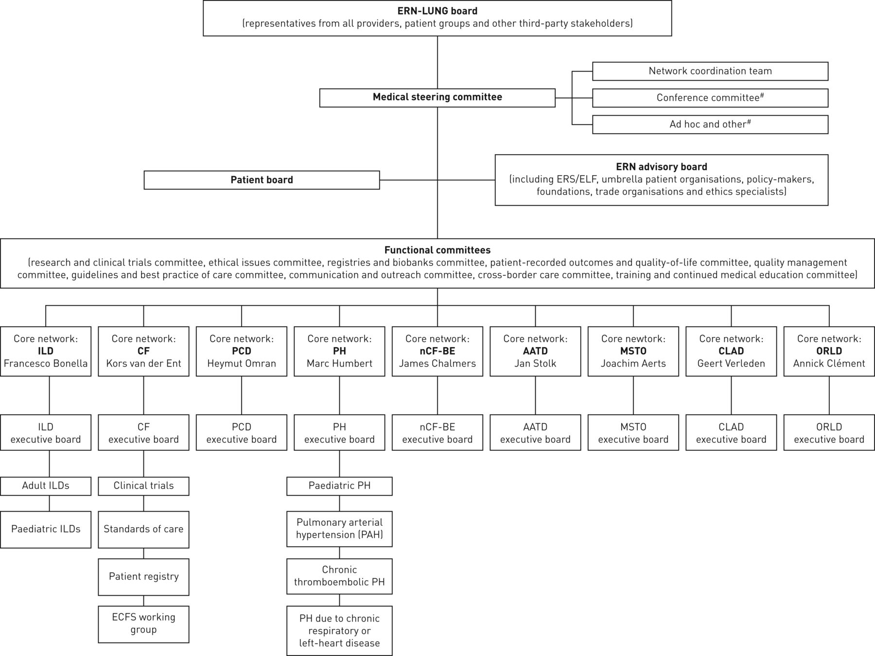
European Reference Network
CF Better together
15
Newborn CF screening Ildikó Horváth
15

Slide 16
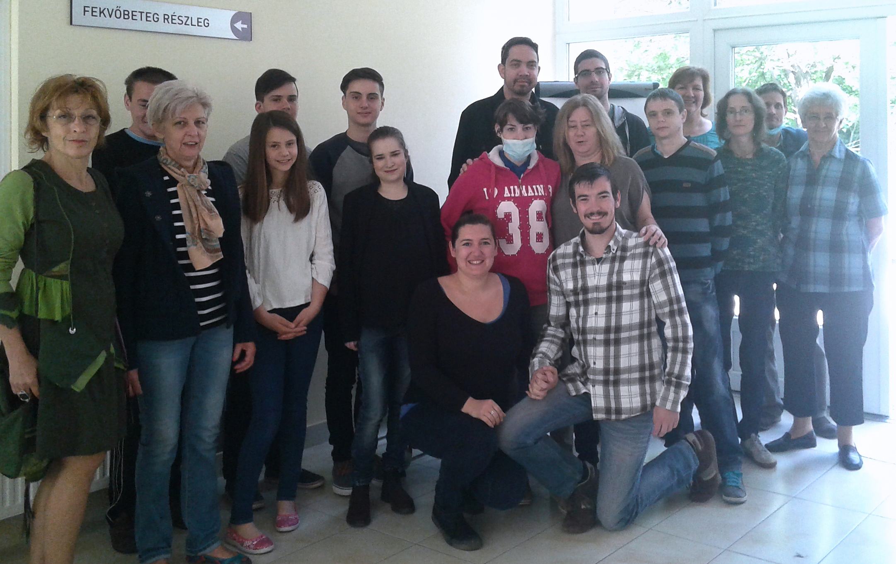
CF Better together
16
Newborn CF screening Ildikó Horváth
16

